Slide 1

POL 2012: Theories and Models in Political Economy
Marxist economics
Espen Moe
Department of Sociology and Political Science
espen.moe@ntnu.no, #9587, 73592230

Slide 2
Today’s lecture
Marxist economics

Slide 3
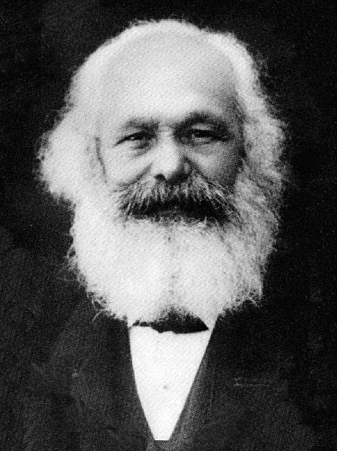
Marxism
Marx (1818-83) is dead!
(Or is he…?)
Key figure in the history of economic thought
(…whether he is dead or not…)
Provides a framework for understanding capitalism
Attempt at understanding capitalism in its entirety
Classical/neoclassical understanding too narrow
Its emergence from feudalism
Internal dynamics and contradictions
Restless, evolutionary, revolutionary → program for action!
Has been extremely influential
Economically and politically
And possibly on his way back in again…

Slide 4
Origins and historical context
Pre-ind. rev.: Jean-Jacques Rousseau (1712-78)
Industrial revolution: Capitalism is not working(?)
Structural changes:
From merchants to manufacturers
From landowners to industrialists
But for the workers? Seemingly no improvement
Wages stagnant
Work-days long (14-18h)
Low-skill industries
Factories, mines
Even authorities worried
Bad soldiers
Revolutionary potential

Slide 5
Criticism of capitalism
Lack of class understanding
Exploitation
Growth of monopoly power
Expansionary nature of capitalism
Uneven development
Commodification
Alienation
State serves capitalist interests
Capitalism can not provide social change

Slide 6
Criticism of capitalism: Method of Marxism
Historical
Materialist
Dialectic
Praxis

Slide 7
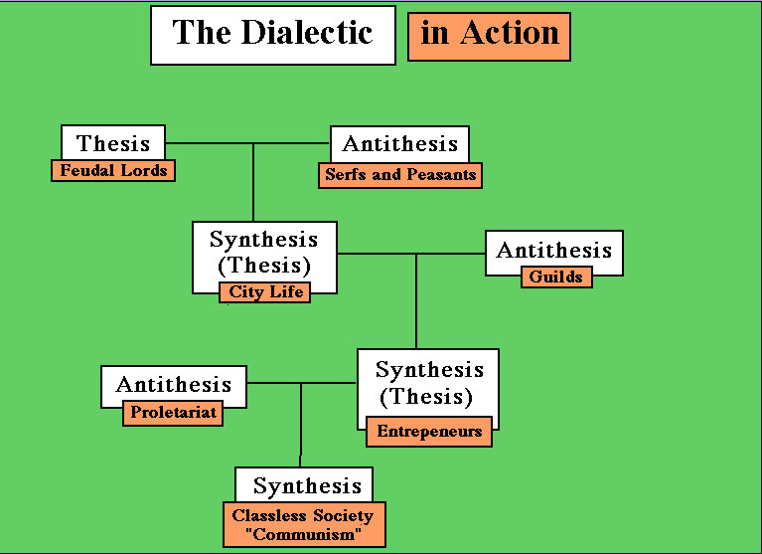

Slide 8
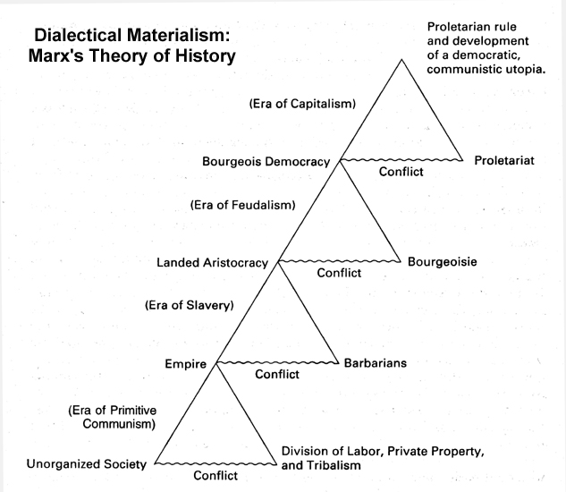

Slide 9
Mode of production and economic structure
Production and structure key to understanding Marxism
Both neglected by classical/neoclassical
Organization of production extremely important
Neoclassical: Exchange
Forces of production and relations of production
Capitalism as a mode of production
Focus on capital vs. labor
Separation of labor from the ownership of the means of production
One class has the ownership of the means of production
One class survives by selling its labor power

Slide 10
Are capitalists bad? Capitalism?
Is capitalism bad?
Highly progressive system
A huge step forward
But no social progress in capitalism
Are capitalists evil?
Nope! (As good or evil as any other human being…)
Capitalist behavior stems from the structure.
Cannot behave in any other way
Exploitation is systemic/structural
Conflict of interest is structurally embedded in the system
Marxist level of analysis: Structural – doesn’t matter if individuals are good or evil
Neoclassical level of analysis: Micro/individual or meso/firm
Not structural. No program for structural change (or any other change)
At the same time: Taking structure for granted, just adapting to it.

Slide 11
Exploitation
Workers:
Produce value over and above what is returned to them
Surplus value (profit)
Shareholders, managers, supervisors, etc.
Banks, financial institutions
Government
Wages: Determined by class struggle
Lots of actors interest in minimizing wages and maximizing surplus value
Exploitation:
Any situation where one class derives income from the labor of another class
Freedom only to work for employers seeking to extract surplus value

Slide 12
Capital accumulation
Accumulation of capital the driving force of capitalism
Businesses seek profits, invest in new equipment in order to expand output and market shares
For the overall economy, economic growth depends on the rapidity of the capital accumulation process
System constantly changing
Labor and its reserve army
Concentration and centralization of capital
Imperialism

Slide 13
Reproduction, growth and change
Minimizing production costs
Extending the geographical area
Hiring people from new social groups at lower wage rates
Unemployment
Increasing surplus value
Pushing production costs down
Increasing the volume and value of goods and services
Raising the productivity of labor
Raising the intensity of labor
Mechanizing production
Realizing surplus value
Marketing the products – commercialization of life
Grow consumer demand
Extend credit facilities
Capitalism very good at this!
Social institutions that underpin/legitimize the system
Coercive backup
Micro level action by actors pursuing their own self-interest. Very adaptable!
But only within certain limits?

Slide 14
Economic crises
Capitalism is doomed to recurring economic crisis
Neoclassical economics: An economics of incrementalism
Marxist economics: An economics of shocks
Neoclassical: Very fast to adapt to new circumstances → new equilibria
Marxist critique: But no central planner → shocks lead to major disequilibria, long periods of recessions, persistent unemployment
Disproportionalities
Falling profit rates
Underconsumption

Slide 15
Conclusions
Capitalism has internal contradictions
Attempt at a historical analysis of the economy
Attempt at being both positive and normative
Scientific, but not value-free!
Unraveling the mechanisms behind social and economic change
Marxism as a call for action
Internal contradictions doesn’t mean that it will just collapse by itself…!
But recurring crises
Focus on injustices: Exploitation
Focus on structures: Exploitation inevitable
Exploitation can only end by the structure changing

